Slide 1
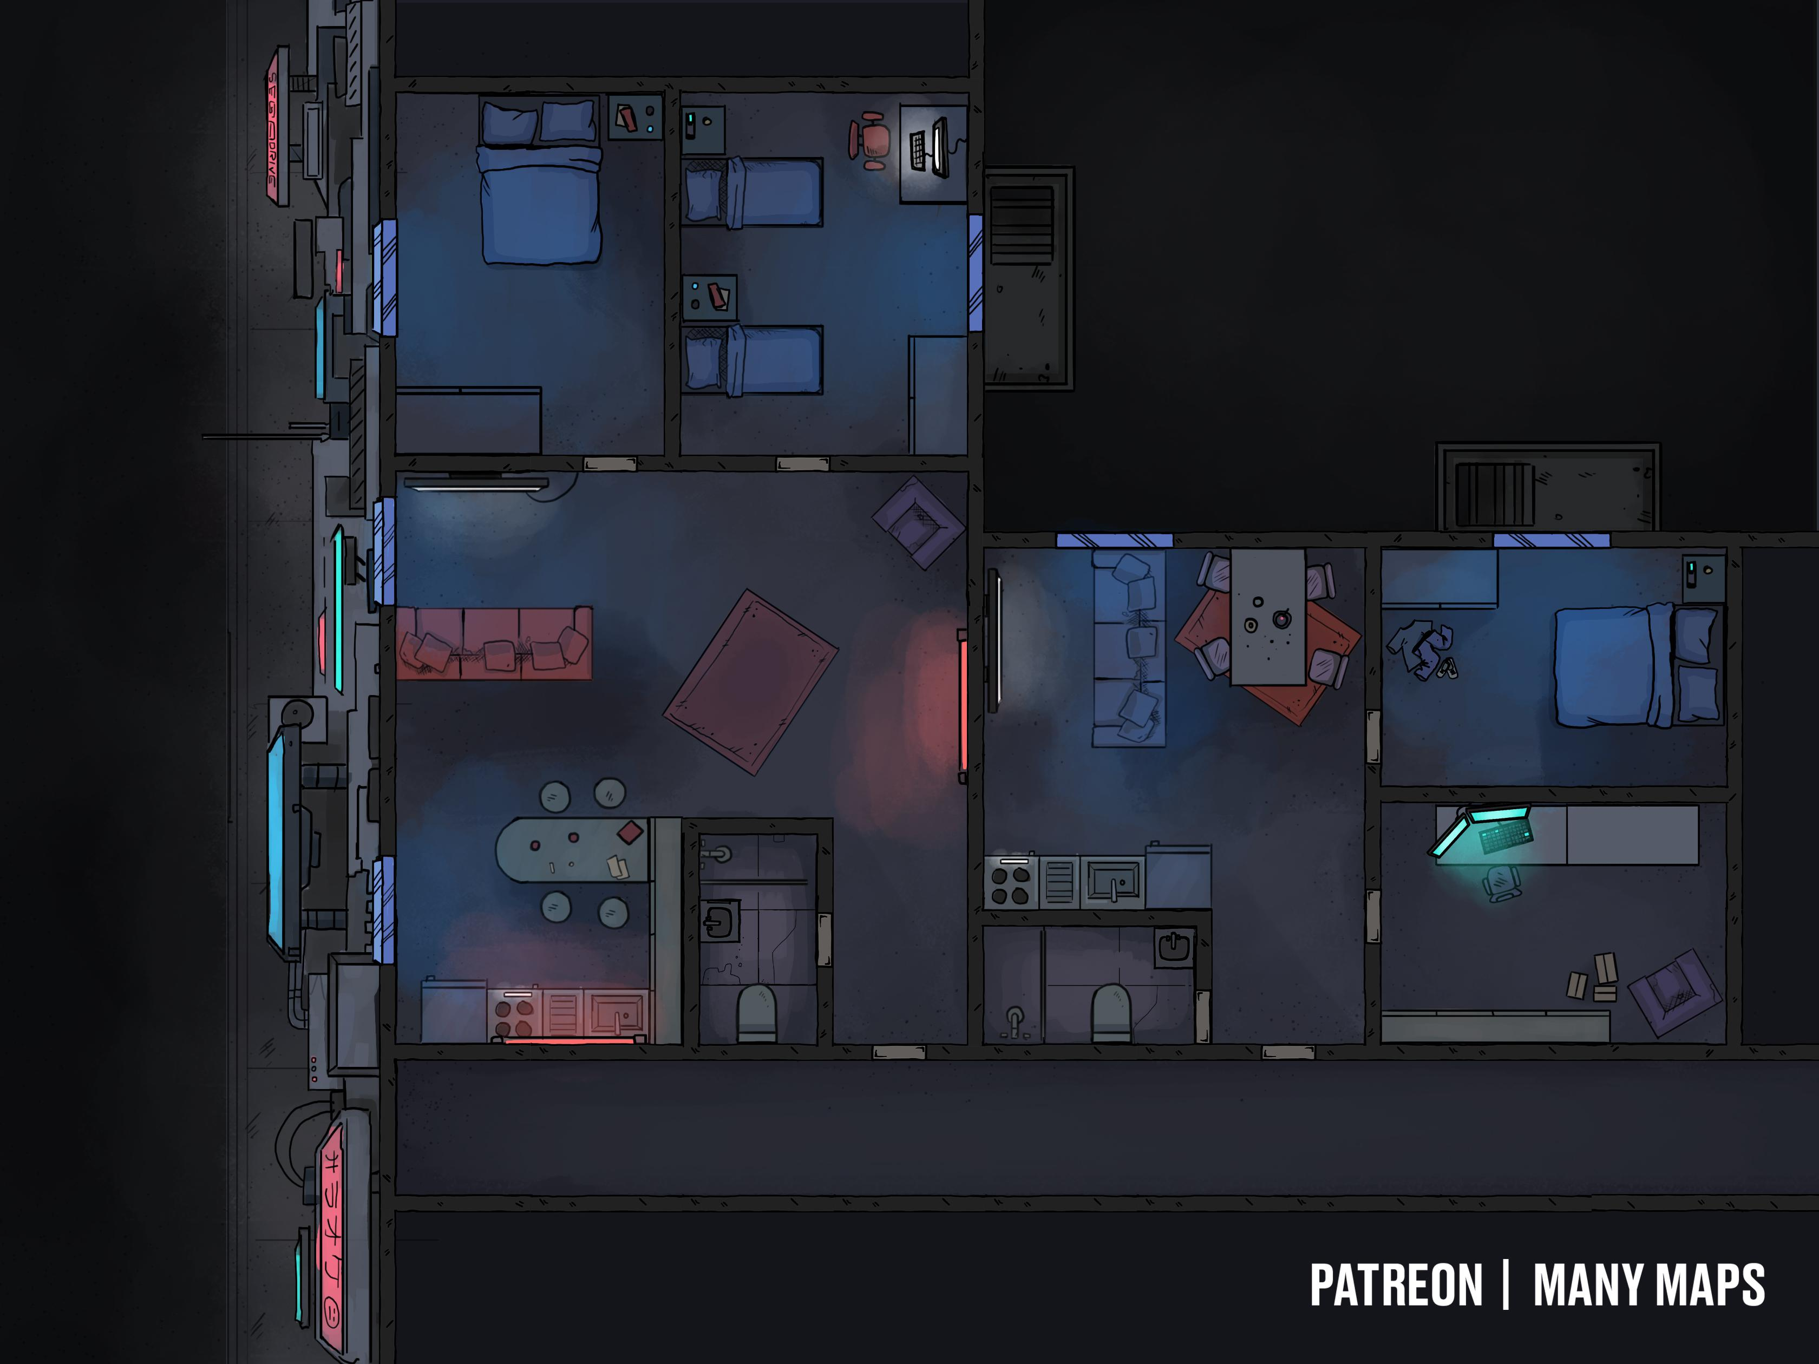
The Hook: Hatsune Akemi (a famous AI pop-star) is about to be slandered by Darnell Gundersen (a low-level Ares social media personality). The Job: Get into Gundersen’s apartment and upload a program to his private server. Pay: 500¥ up front, 500¥ on completion + 200% bonus for discretion (max 3k per runner).
Scene 1 (Social). Setting: The Black Cat, a grungy bar in Auburn. Seattle Map. The Hook: Runners were told by their fixers to meet here for a job. Given dossiers with images, major skills, names of the rest of the team (have players introduce their characters). Events: Influence + CHA (3) – Bartender directs the player to a back room where Mr. Johnson awaits. Influence + CHA (7) – players get the name of the client. Negotiation: per SMG p16, vs Influence 6 CHA 5, 5% increase/decrease in base pay per hit (max still 3k per SMG).
Scene 2 (Investigation). Setting: per players. Available Info:
Gundersen lives in a small Ares run arcology Downtown.
Lone Star has a base for fast response on a lower level. Base response time: per Security Rating B (CRB p239)
After a break-in last year, Ares hired a firm to update Gundersen's matrix security. Target network is airgapped and behind a separate firewall host (per CRB p186 diagram, but no standing connection to Matrix).
Gundersen is a small time Ares-backed social media presence. Odds are his personal network isn't too hard once accessed (rating approx 4-6). He probably can't afford his own security beyond building security.
Apartment is protected by routine Ares wards / spirits for lower-level public personas (Security Rating B, CRB p239)
Optional Rules for Initiative. Purpose: Get all players involved in all scenes at First Taste. Social: Influence + CHA. # hits determines order. Ties: Edge, CHA, INT, Coin Flip. Investigation: Perception + INT. # hits determines order. Ties: Edge, INT, REA, Coin Flip.
Scene 3 (Investigation). Setting: The Ares arcology. Edge: 1 per 2 successes in Scene 2 for each player (max 2). Challenges: SIN Check to enter the building. 2nd SIN Check to access elevator. Maglocked Door. Airgapped server in room E. Cameras in hallways and rooms. (Optional) Laser trip wires to silent alarm HTR. (Optional) Patrolling watch spirits alert HTR. (Optional) Ares Police patrol area A every five minutes.
Map Legend. A: A hallway on 72nd Floor. B: An unoccupied apartment. C: Gundersen’s apartment. D: Bedroom. E: Guest room and study, where the target server is.
D
E
Scene 4 (Combat). Setting: Area A. Edge: 1 per 2 successes in Scene 3 for each player (max 2). Challenges: 1 enemy per 2 players. Choose from:
Lone Star Patrolman (CRB 206)
SWAT Officer (CRB 207 if HTR triggered)
Combat Mage (CRB 207 if HTR triggered)
Security Rigger (CRB 206)
C
B
A
Preemptive Revenge
A Shadowrun 6e First Taste by Zeshan Rajput
https://creativecommons.org/licenses/by-sa/3.0/
CRB: Shadowrun 6th Edition Core Rule Book
SMG: Shadowrun Missions Guide v1.6
Map Credit: u/Kandru1L on r/Shadowrun
Picking Up the Pieces. Pay: negotiated base pay +
1000¥ if no physical evidence
500¥ if no matrix or technology evidence
500¥ if no astral or magical evidence
Max 3k per player
Karma: 3 karma for adventure survival.
Contacts: Hatsune Akemi (Media – Music; Connections 5, Loyalty 1) if exceptional mission success. Next day: Ares fires Gundersen after images of a sex scandal leak.

